Slide 1
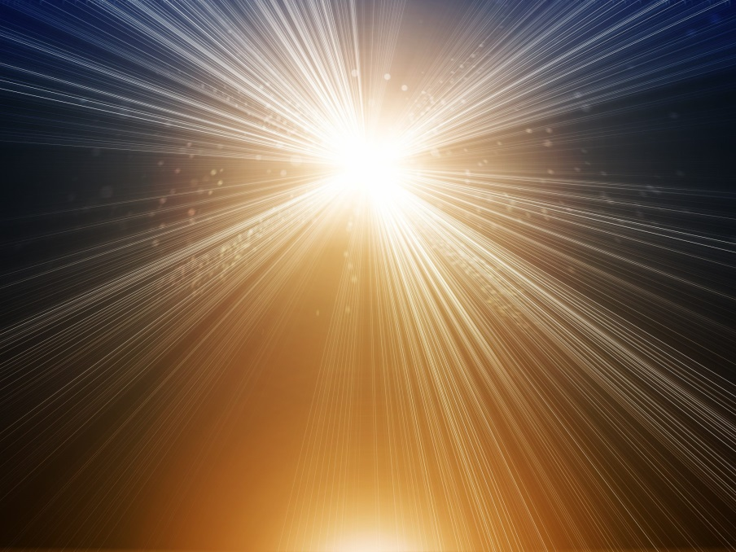
The Power Of The Word Of God
Genesis 1:1-31

Slide 2
The Power of the Word of God
Genesis 1:1-5 (NKJV): In the beginning God created the heavens and the earth. The earth was without form, and void; and darkness was on the face of the deep. And the Spirit of God was hovering over the face of the waters. Then God said, “Let there be light”; and there was light. And God saw the light, that it was good; and God divided the light from the darkness. God called the light Day, and the darkness He called Night. So the evening and the morning were the first day.

Slide 3
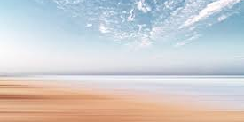
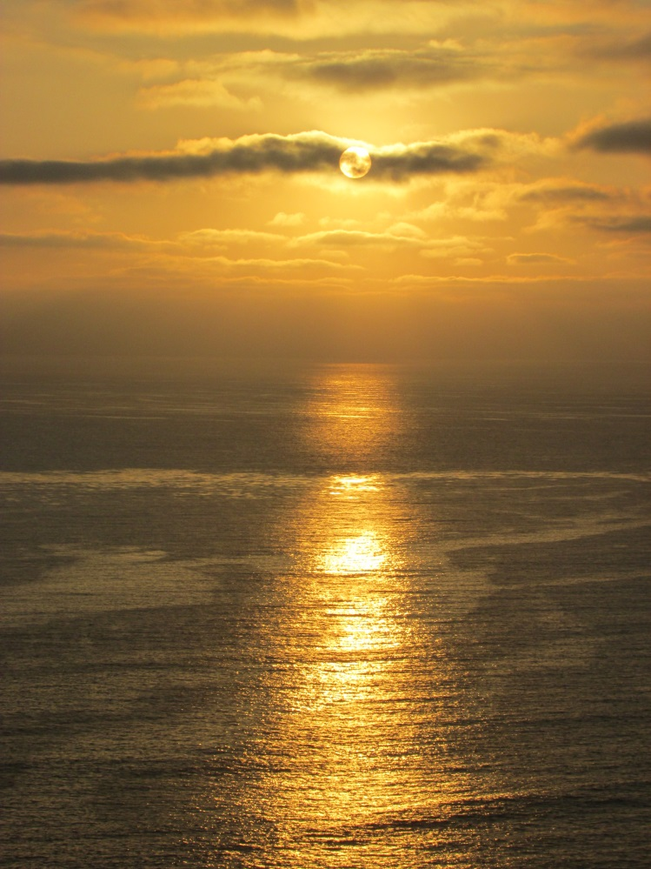
The Power of the Word of God
Genesis 1:6-8 (NKJV): Then God said, “Let there be a firmament in the midst of the waters, and let it divide the waters from the waters.” Thus God made the firmament, and divided the waters which were under the firmament from the waters which were above the firmament; and it was so. And God called the firmament Heaven. So the evening and the morning were the second day.
Isaiah 45:18 (NKJV): For thus says the LORD, Who created the heavens, Who is God, Who formed the earth and made it, Who has established it, Who did not create it in vain, Who formed it to be inhabited: "I am the LORD, and there is no other.

Slide 4
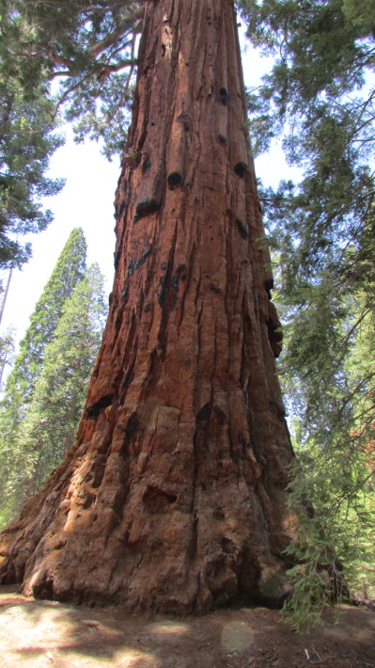
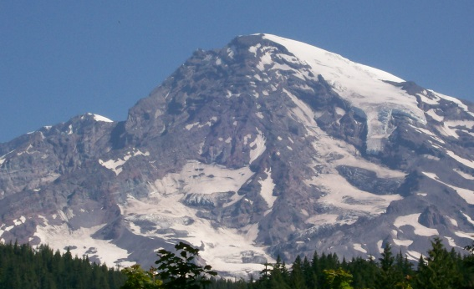
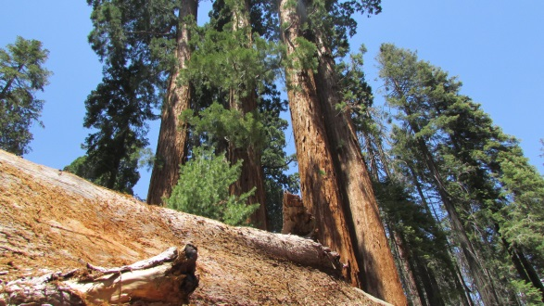
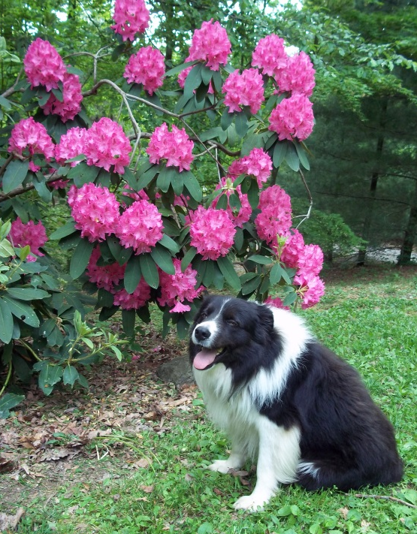
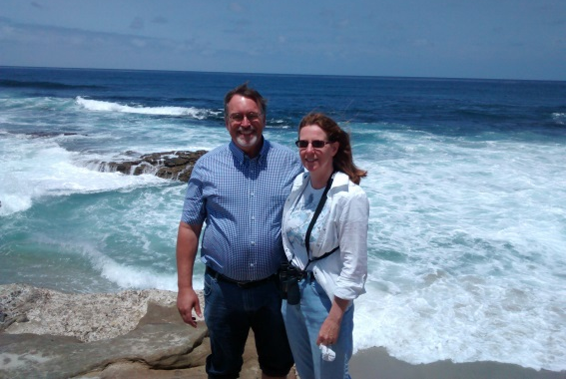
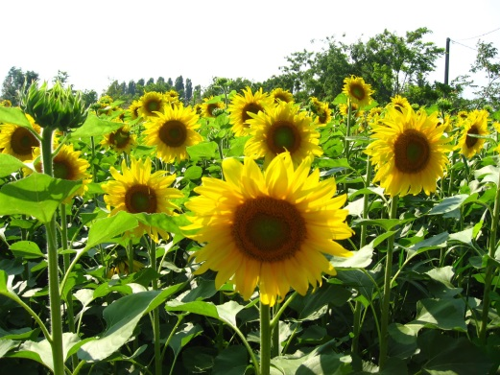
The Power of the Word of God
Genesis 1:9-13 (NKJV): Then God said, “Let the waters under the heavens be gathered together into one place, and let the dry land appear”; and it was so. And God called the dry land Earth, and the gathering together of the waters He called Seas. And God saw that it was good. Then God said, “Let the earth bring forth grass, the herb that yields seed, and the fruit tree that yields fruit according to its kind, whose seed is in itself, on the earth”; and it was so. And the earth brought forth grass, the herb that yields seed according to its kind, and the tree that yields fruit, whose seed is in itself according to its kind. And God saw that it was good. So the evening and the morning were the third day.

Slide 5
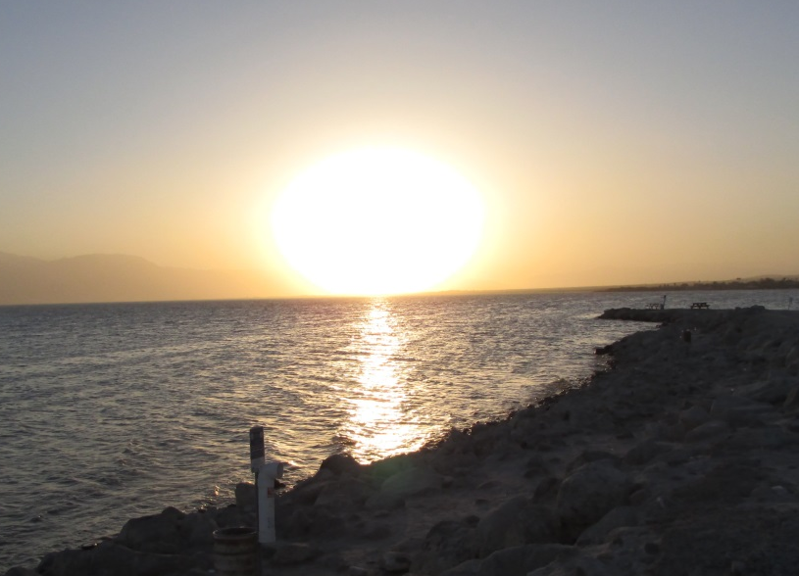
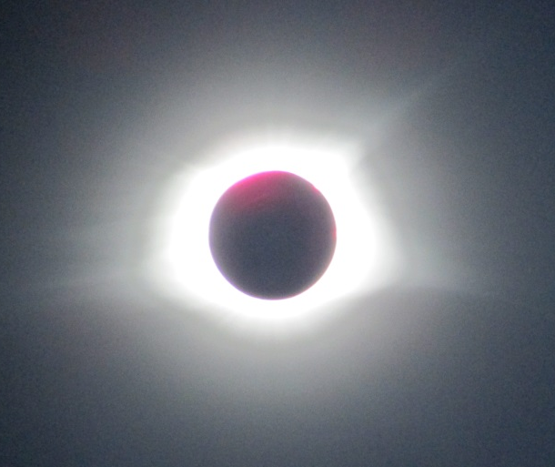
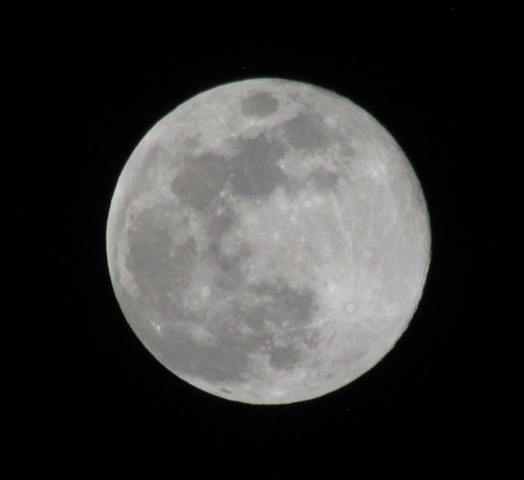
The Power of the Word of God
Genesis 1:14-19 (NKJV): Then God said, “Let there be lights in the firmament of the heavens to divide the day from the night; and let them be for signs and seasons, and for days and years; and let them be for lights in the firmament of the heavens to give light on the earth”; and it was so. Then God made two great lights: the greater light to rule the day, and the lesser light to rule the night. He made the stars also. God set them in the firmament of the heavens to give light on the earth, and to rule over the day and over the night, and to divide the light from the darkness. And God saw that it was good. So the evening and the morning were the fourth day.

Slide 6
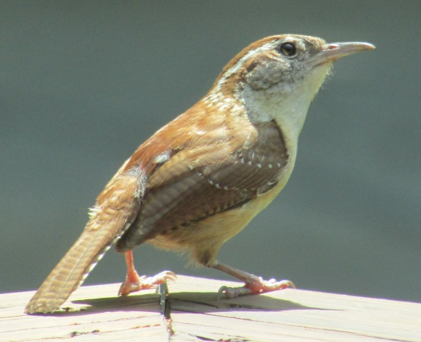
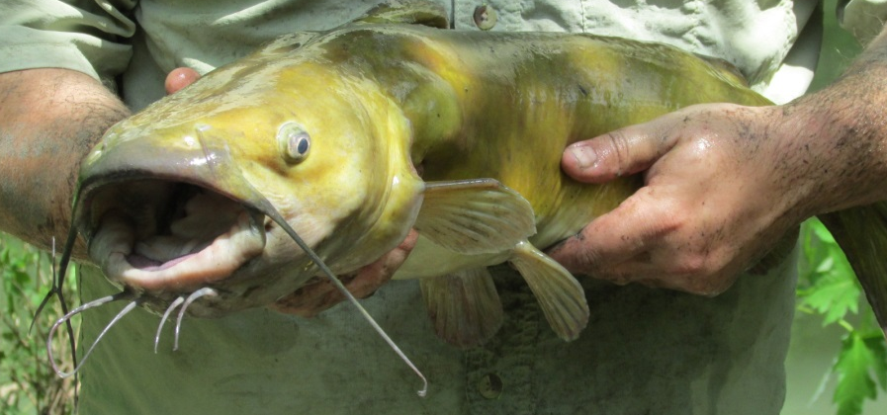
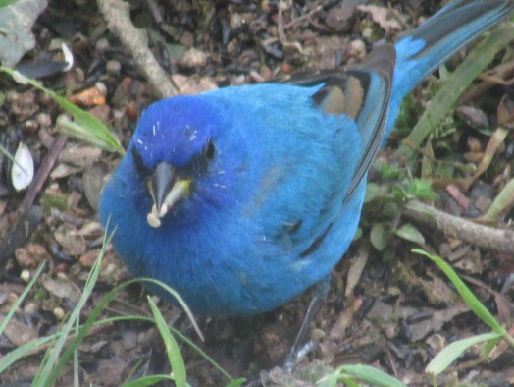
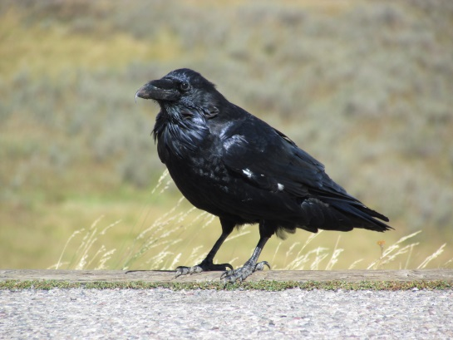
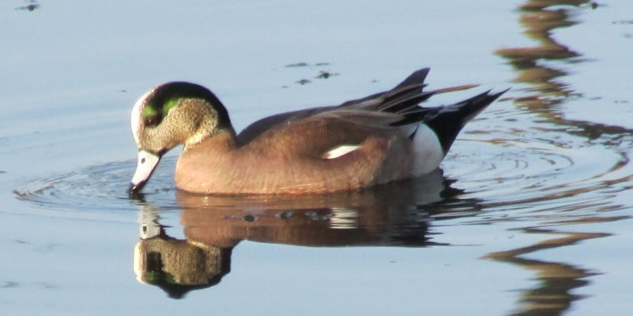
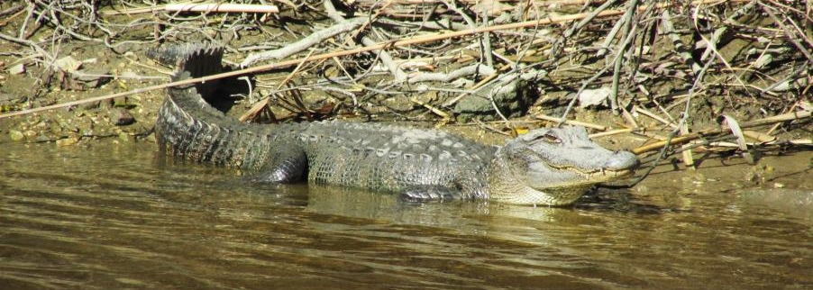
The Power of the Word of God
Genesis 1:20-23 (NKJV): Then God said, “Let the waters abound with an abundance of living creatures, and let birds fly above the earth across the face of the firmament of the heavens.” So God created great sea creatures and every living thing that moves, with which the waters abounded, according to their kind, and every winged bird according to its kind. And God saw that it was good. And God blessed them, saying, “Be fruitful and multiply, and fill the waters in the seas, and let birds multiply on the earth.” So the evening and the morning were the fifth day.

Slide 7
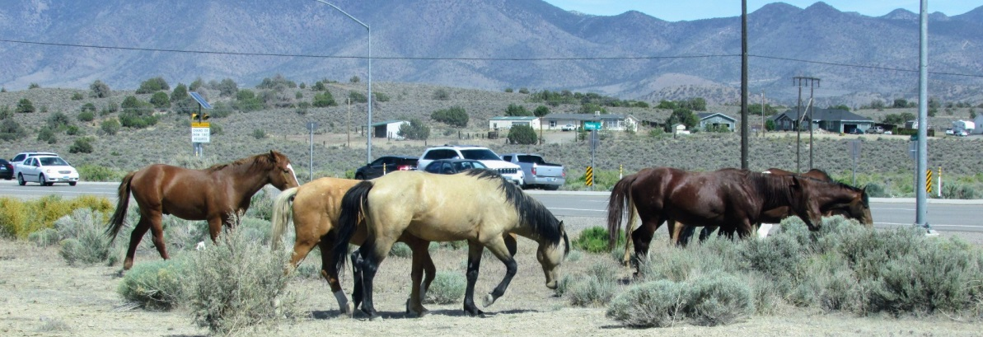
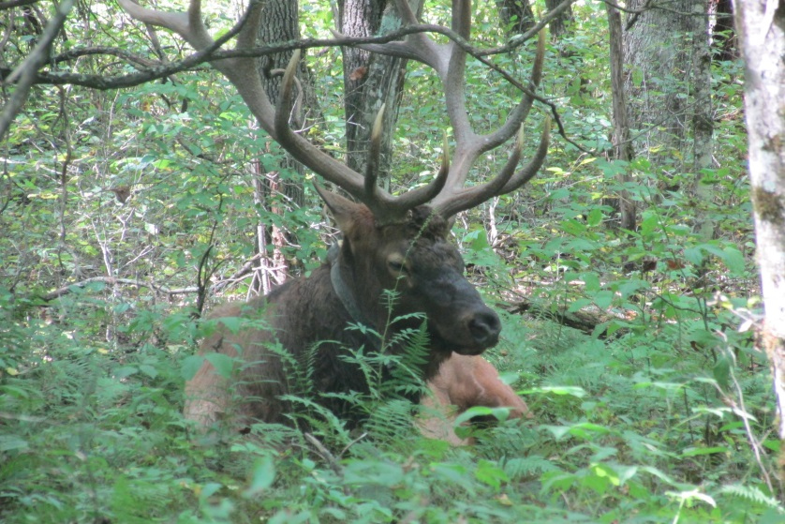
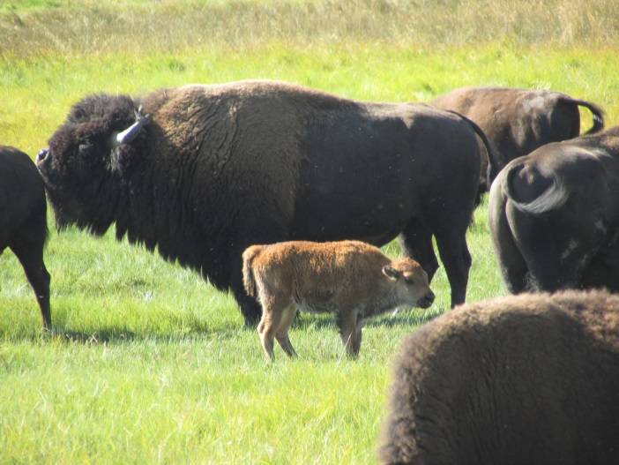
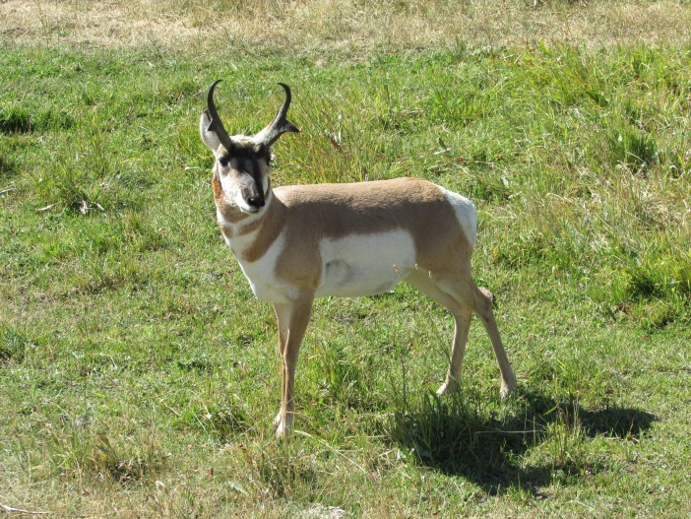
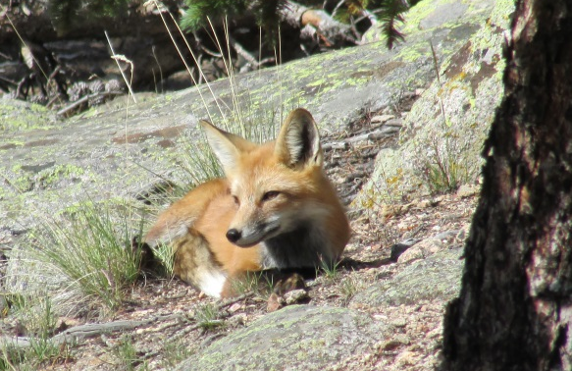
The Power of the Word of God
Genesis 1:24-25 (NKJV): Then God said, “Let the earth bring forth the living creature according to its kind: cattle and creeping thing and beast of the earth, each according to its kind”; and it was so. And God made the beast of the earth according to its kind, cattle according to its kind, and everything that creeps on the earth according to its kind. And God saw that it was good.

Slide 8
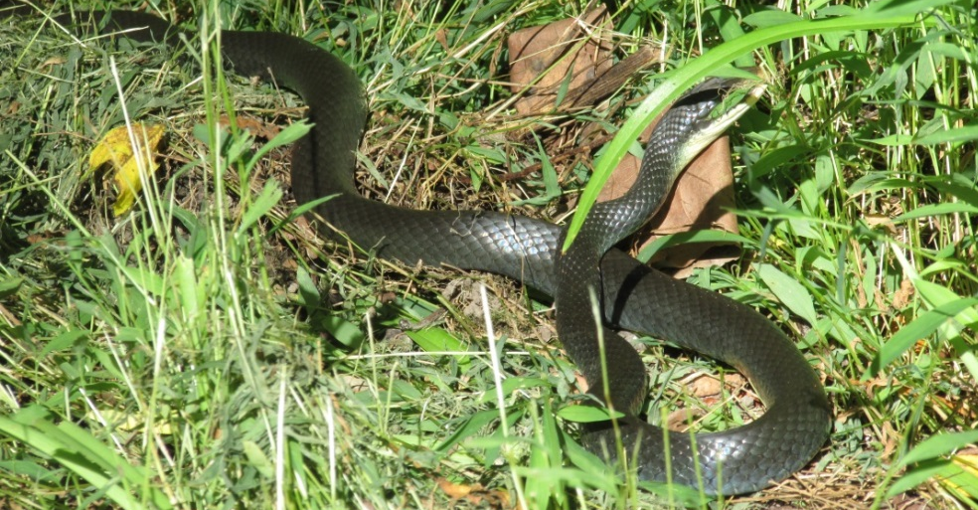
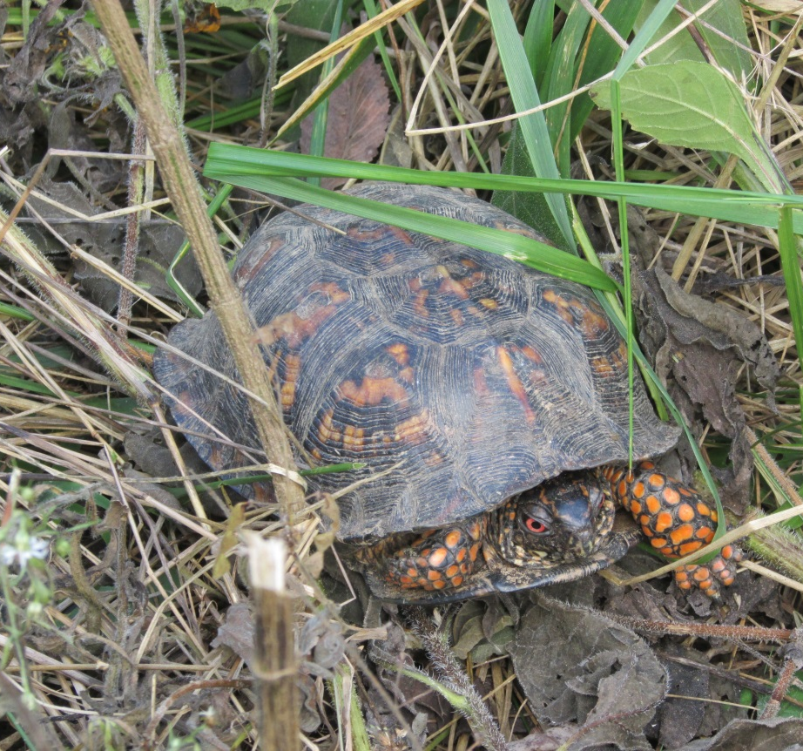
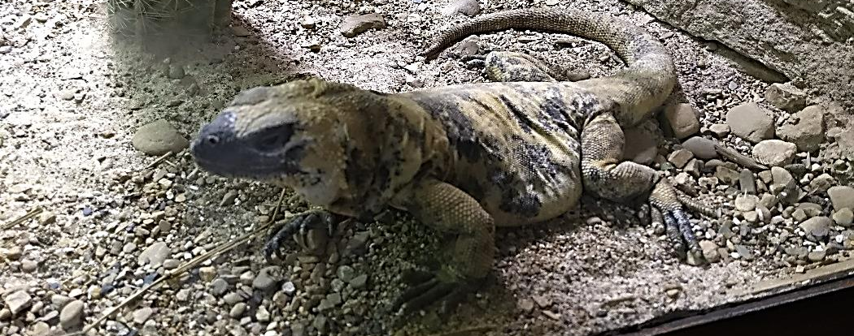
The Power of the Word of God
Genesis 1:24-25 (NKJV): Then God said, “Let the earth bring forth the living creature according to its kind: cattle and creeping thing and beast of the earth, each according to its kind”; and it was so. And God made the beast of the earth according to its kind, cattle according to its kind, and everything that creeps on the earth according to its kind. And God saw that it was good.

Slide 9
The Power of the Word of God
Genesis 1:26-31 (NKJV): Then God said, “Let Us make man in Our image, according to Our likeness; let them have dominion over the fish of the sea, over the birds of the air, and over the cattle, over all the earth and over every creeping thing that creeps on the earth.” So God created man in His own image; in the image of God He created him; male and female He created them. Then God blessed them, and God said to them, “Be fruitful and multiply; fill the earth and subdue it; have dominion over the fish of the sea, over the birds of the air, and over every living thing that moves on the earth.” And God said, “See, I have given you every herb that yields seed which is on the face of all the earth, and every tree whose fruit yields seed; to you it shall be for food. Also, to every beast of the earth, to every bird of the air, and to everything that creeps on the earth, in which there is life, I have given every green herb for food”; and it was so. Then God saw everything that He had made, and indeed it was very good. So the evening and the morning were the sixth day.

Slide 10
The Power of the Word of God
Psalm 33:6-9 (NKJV): By the word of the LORD the heavens were made, And all the host of them by the breath of His mouth. He gathers the waters of the sea together as a heap; He lays up the deep in storehouses. Let all the earth fear the LORD; Let all the inhabitants of the world stand in awe of Him. For He spoke, and it was done; He commanded, and it stood fast.
John 1:1-5 (NKJV): In the beginning was the Word, and the Word was with God, and the Word was God. He was in the beginning with God. All things were made through Him, and without Him nothing was made that was made. In Him was life, and the life was the light of men. And the light shines in the darkness, and the darkness did not comprehend it.
John 1:14 (NKJV): And the Word became flesh and dwelt among us, and we beheld His glory, the glory as of the only begotten of the Father, full of grace and truth.

Slide 11
The Power of the Word of God
Genesis 7:11-16 (NKJV): In the six hundredth year of Noah’s life, in the second month, the seventeenth day of the month, on that day all the fountains of the great deep were broken up, and the windows of heaven were opened. And the rain was on the earth forty days and forty nights. On the very same day Noah and Noah’s sons, Shem, Ham, and Japheth, and Noah's wife and the three wives of his sons with them, entered the ark – they and every beast after its kind, all cattle after their kind, every creeping thing that creeps on the earth after its kind, and every bird after its kind, every bird of every sort. And they went into the ark to Noah, two by two, of all flesh in which is the breath of life. So those that entered, male and female of all flesh, went in as God had commanded him; and the LORD shut him in.
Genesis 8:1-3 (NKJV): Then God remembered Noah, and every living thing, and all the animals that were with him in the ark. And God made a wind to pass over the earth, and the waters subsided. The fountains of the deep and the windows of heaven were also stopped, and the rain from heaven was restrained. And the waters receded continually from the earth. At the end of the hundred and fifty days the waters decreased.

Slide 12
The Power of the Word of God
Genesis 9:1-2 (NKJV): So God blessed Noah and his sons, and said to them: “Be fruitful and multiply, and fill the earth. And the fear of you and the dread of you shall be on every beast of the earth, on every bird of the air, on all that move on the earth, and on all the fish of the sea. They are given into your hand.”
Genesis 9:12-16 (NKJV): And God said: “This is the sign of the covenant which I make between Me and you, and every living creature that is with you, for perpetual generations: I set My rainbow in the cloud, and it shall be for the sign of the covenant between Me and the earth. It shall be, when I bring a cloud over the earth, that the rainbow shall be seen in the cloud; and I will remember My covenant which is between Me and you and every living creature of all flesh; the waters shall never again become a flood to destroy all flesh. The rainbow shall be in the cloud, and I will look on it to remember the everlasting covenant between God and every living creature of all flesh that is on the earth.”

Slide 13
The Power of the Word of God
Psalm 104:5-9 (NKJV): You who laid the foundations of the earth, So that it should not be moved forever, You covered it with the deep as with a garment; The waters stood above the mountains. At Your rebuke they fled; At the voice of Your thunder they hastened away. They went up over the mountains; They went down into the valleys, To the place which You founded for them. You have set a boundary that they may not pass over, That they may not return to cover the earth.

Slide 14
The Power of the Word of God
Hebrews 4:12 (NKJV): For the word of God is living and powerful, and sharper than any two-edged sword, piercing even to the division of soul and spirit, and of joints and marrow, and is a discerner of the thoughts and intents of the heart.
Romans 1:16 (NKJV): For I am not ashamed of the gospel of Christ, for it is the power of God to salvation for everyone who believes, for the Jew first and also for the Greek.

Slide 15
The Power of the Word of God
2 Peter 3:1-9 (NKJV): Beloved, I now write to you this second epistle (in both of which I stir up your pure minds by way of reminder), that you may be mindful of the words which were spoken before by the holy prophets, and of the commandment of us, the apostles of the Lord and Savior, knowing this first: that scoffers will come in the last days, walking according to their own lusts, and saying, “Where is the promise of His coming? For since the fathers fell asleep, all things continue as they were from the beginning of creation.” For this they willfully forget: that by the word of God the heavens were of old, and the earth standing out of water and in the water, by which the world that then existed perished, being flooded with water. But the heavens and the earth which are now preserved by the same word, are reserved for fire until the day of judgment and perdition of ungodly men. But, beloved, do not forget this one thing, that with the Lord one day is as a thousand years, and a thousand years as one day. The Lord is not slack concerning His promise, as some count slackness, but is longsuffering toward us, not willing that any should perish but that all should come to repentance.

Slide 16
The Power of the Word of God
2 Peter 3:10-14 (NKJV): But the day of the Lord will come as a thief in the night, in which the heavens will pass away with a great noise, and the elements will melt with fervent heat; both the earth and the works that are in it will be burned up. Therefore, since all these things will be dissolved, what manner of persons ought you to be in holy conduct and godliness, looking for and hastening the coming of the day of God, because of which the heavens will be dissolved, being on fire, and the elements will melt with fervent heat? Nevertheless we, according to His promise, look for new heavens and a new earth in which righteousness dwells. Therefore, beloved, looking forward to these things, be diligent to be found by Him in peace, without spot and blameless

Slide 17
The Power of the Word of God
1 Peter 3:19-22 (NKJV): by whom also He went and preached to the spirits in prison, who formerly were disobedient, when once the Divine longsuffering waited in the days of Noah, while the ark was being prepared, in which a few, that is, eight souls, were saved through water. There is also an antitype which now saves us – baptism (not the removal of the filth of the flesh, but the answer of a good conscience toward God), through the resurrection of Jesus Christ, who has gone into heaven and is at the right hand of God, angels and authorities and powers having been made subject to Him.

Slide 18
The Power of the Word of God
Hebrews 11:1-3 (NKJV): Now faith is the substance of things hoped for, the evidence of things not seen. For by it the elders obtained a good testimony. By faith we understand that the worlds were framed by the word of God, so that the things which are seen were not made of things which are visible.
Hebrews 11:6-7 (NKJV): But without faith it is impossible to please Him, for he who comes to God must believe that He is, and that He is a rewarder of those who diligently seek Him. By faith Noah, being divinely warned of things not yet seen, moved with godly fear, prepared an ark for the saving of his household, by which he condemned the world and became heir of the righteousness which is according to faith.

